Slide 1

Global growth development indicators analysis
Group 5

Slide 2
To define our clustering project goal based on the columns provided,
we need to analyze the data and identify patterns or relationships among the variables.
Here are some possible goals we could consider with the given data:
Cluster countries based on their economic indicators:
GDP
Business tax rate
Lending interest
Energy usage
Cluster countries based on their social indicators:
Birth rate
Infant mortality rate
Life expectancy (female and male)
Population demographics (0-14, 15-64, 65+)
Health expenditure (GDP and per capita)
Cluster countries based on their environmental indicators:
CO2 emissions
Energy usage
Cluster countries based on a combination of economic, social, and environmental indicators to identify overall development levels.

Slide 3
Business understanding about project
Based on the given data here are a few potential segmentation approaches that we have considered for our clustering project:
Economic Segmentation
Demographic Segmentation
Technological Segmentation
Health and Social Segmentation

Slide 4
Economic Segmentation : Economic variables like "GDP," "CO2 Emissions," "Tourism Inbound," "Tourism Outbound," "Lending Interest," and "Business Tax Rate" can be used for economic segmentation. This approach can identify countries or regions with similar economic characteristics, such as GDP levels, tourism activities, or business regulations.
Cluster 1:(DEVELOPED)
Cluster 2: (DEVELOPING and HIGHER GDP GROWTH)
Cluster 3: (DEVELOPING AND LOWER GDP GROWTH)
Cluster4: (UNDER DEVELOPED COUNTRIED)

Slide 5
Demographic Segmentation using the provided population-related variables, we can expect the final classification to group countries or regions based on their population size, age distribution, and urbanization levels.
Cluster 1: Countries/regions with a large population size, high urbanization rates, and a significant proportion of the population in the age group 15-64.
This cluster may represent highly populated and urbanized areas with a significant working-age population.
Cluster 2: Countries/regions with a smaller population size, lower urbanization rates, and a relatively higher proportion of the population in the age group 0-14.
This cluster may represent areas with a younger population and lower urbanization levels, potentially indicating regions with higher birth rates or less developed urban areas.
Cluster 3: Countries/regions with a significant proportion of the population in the age group 65+, potentially indicating an aging population.
This cluster may represent regions with a larger elderly population, which might have implications for healthcare, pension systems, and social policies.
Cluster 1: "Urbanized" or "Working-age" Cluster 2: "Youthful" or "Developing" Cluster 3: "Aging" or "Elderly"

Slide 6
Technological Segmentation: Variables such as "Mobile Phone Usage," "Internet Usage," and "Energy Usage" can be used for technological segmentation. This approach can help identify countries or regions with similar levels of technology adoption or energy consumption patterns.
Cluster 1: Countries/regions with high mobile phone usage, high internet usage, and high energy usage.
This cluster may represent countries or regions with advanced technology infrastructure, widespread use of mobile phones and internet services, and high energy consumption for technological purposes.
Cluster 2: Countries/regions with moderate mobile phone usage, moderate internet usage, and moderate energy usage.
This cluster may represent countries or regions with a moderate level of technology adoption, average use of mobile phones and internet services, and moderate energy consumption for technological purposes.
Cluster 3: Countries/regions with low mobile phone usage, low internet usage, and low energy usage.
This cluster may represent countries or regions with limited technology adoption, lower use of mobile phones and internet services, and lower energy consumption for technological purposes.
Cluster 1: "High-Tech" or "Tech-Advanced" Cluster 2: "Moderate-Tech" or "Tech-Balanced" Cluster 3: "Low-Tech" or "Tech-Limited"

Slide 7
Health and Social Segmentation: Variables like "Birth Rate," "Life Expectancy Male," "Life Expectancy Female," "Infant Mortality Rate," "Health Exp/Capita," and "Health Exp % GDP" can be used for segmentation related to health and social indicators. This segmentation can help identify groups of countries with similar health outcomes, healthcare spending, or life expectancy.
Cluster 1: Countries/regions with low birth rates, high life expectancy (both male and female), low infant mortality rates, high health expenditure per capita, and a significant portion of GDP spent on health.
This cluster may represent countries or regions with strong health indicators, low infant mortality rates, higher life expectancy, and relatively higher investment in healthcare.
Cluster 2: Countries/regions with moderate birth rates, moderate life expectancy (both male and female), moderate infant mortality rates, moderate health expenditure per capita, and a moderate portion of GDP spent on health.
This cluster may represent countries or regions with moderate health indicators, moderate infant mortality rates, life expectancy, and healthcare spending.
Cluster 3: Countries/regions with high birth rates, lower life expectancy (both male and female), higher infant mortality rates, lower health expenditure per capita, and a lower portion of GDP spent on health.
This cluster may represent countries or regions with relatively poorer health indicators, higher infant mortality rates, lower life expectancy, and limited healthcare resources.
Cluster 1: "Advanced" or "Healthy" Cluster 2: "Moderate" or "Balanced" Cluster 3: "Challenged" or "Underprivileged"

Slide 8
Data Cleaning:
EDA
Handling Missing Values:
Identify missing values.
Assess the impact of missing values.
Decide on handling strategies.
Implement chosen strategy.
Handling Inconsistent Data:
Identify inconsistencies.
Identify and eliminating duplicate
Validate data against business rules.
Eliminating Redundant Features:
Exclude Columns that have Redundant Information
Outlier Detection and Treatment:
Identify outliers.
Assess impact and decide treatment.
Implement chosen treatment.
Data Transformation:
Normalize and standardize data.
Handle skewness.
Percentage to values
Data Reduction:
understanding Feature Importance
Data Exploration:
Statistical summaries and descriptive statistics.
Univariate Analysis : Analyze each variable individually to understand its distribution.
Data visualization.
Variable Identification:
Determine the role of each variable grouping variable, and understand their significance in the analysis.

Slide 9
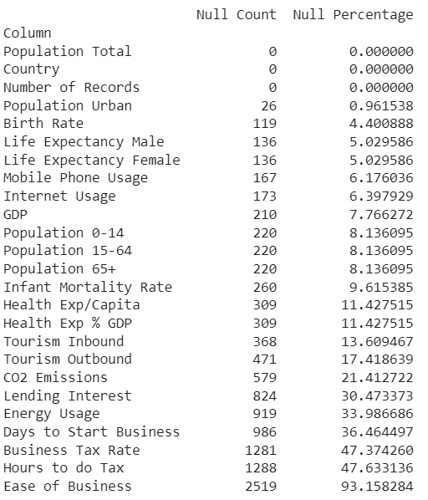
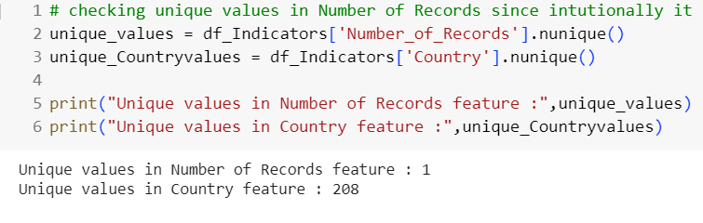
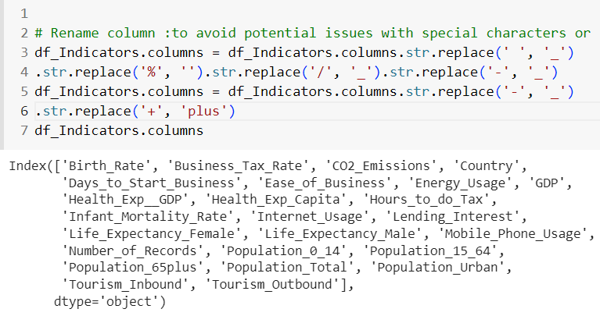
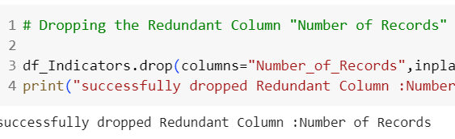
MISSING Values (Null):
Except for Country, Number of Records, and Population Total, all the other columns had null values.
‘Ease of Business ‘ has 93% missing values thus retaining it may include bias .
Redundant Column:
"Number of Records“ has a single unique value ‘1’ implies that the feature lacks variability and does not exhibit any distinguishable patterns within the dataset. Thus this column is dropped.
Column Names:
changed the column names to avoid potential issues with special characters or spaces.

Slide 10
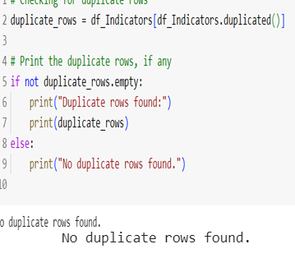
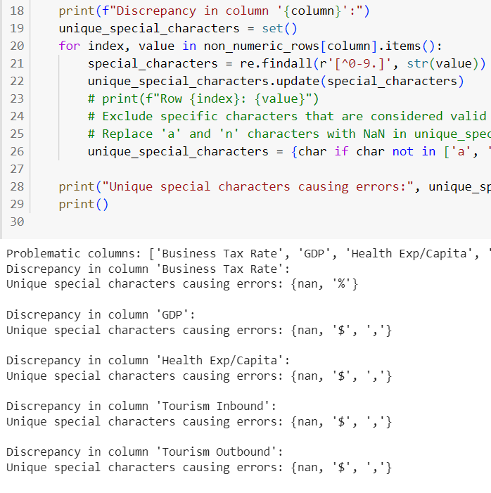
Inconsistent Data:
Identify and eliminating duplicate values
Identify inconsistencies;
Identified and eliminated the special characters present in the data
Column Names:
There are total 208 unique countries and each country has 13 records ,hence we can assume the data is periodic.so we need to have 1 record of each country else our same country will fall in multiple clusters we will take the median of each value since we don’t know the latest record as there is no date.

Slide 11
Handling Missing Values:
Implement chosen strategy : KNN Imputer
We first used the relationship between the population columns
Converted the Population 0-14, Population 15-64 ,Population 65 percentage to values and then imputed the missing values using the formula - sum(Population 0-14, Population 15-64 ,Population 65) = Population Total
Then targeting the least missing values impute itérative for all the columns.

Slide 12
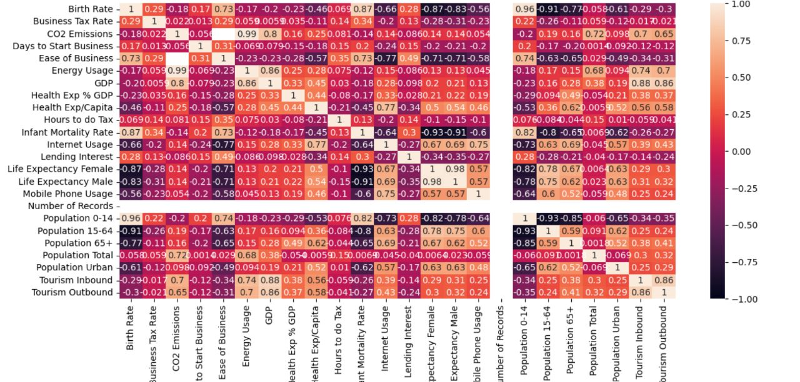
Story telling with Data:
Variable Identification: Determine the role of each variable grouping variable,
and understand their significance in the analysis.
Correlations matrix

Slide 13
Implications for Policy and Healthcare Interventions
Birth Rate and Infant Mortality Rate: The high positive correlation suggests that countries with higher birth rates tend to have higher infant mortality rates. This finding can guide policymakers like UNICEF and healthcare professionals in identifying regions/countries that require improved maternal and child healthcare services and targeted interventions to reduce infant mortality rates.

Slide 14
Strategies for Sustainable Energy Practices and Carbon Footprint Reduction
CO2 Emissions and Energy Usage: The strong positive correlation between CO2 emissions and energy usage indicates that countries with higher energy consumption tend to generate more carbon emissions. This information can be utilized to develop strategies for promoting energy-efficient practices, renewable energy adoption, and carbon footprint reduction initiatives.

Slide 15
Implications for Policy and Support for Aging Populations
Life Expectancy and Population Age Group 65+: The POSITIVE correlations between life expectancy and population age group (65+) indicate that countries with higher life expectancies tend to have higher proportions of youth and older populations. This knowledge can guide policymakers UNESCO and UNICEF in developing policies and programs that address the needs of aging populations, such as healthcare, social welfare, and pension systems.

Slide 16
Strategies for Enhancing Tourism Experiences and Economic Impact
Tourism Inbound and Tourism Outbound: The positive correlation between inbound and outbound tourism suggests that countries with higher tourist arrivals also tend to have higher outbound tourism from their own citizens. This insight can be leveraged by tourism authorities to develop comprehensive tourism strategies that cater to both international tourists and domestic travelers, enhancing the overall tourism experience and economic impact.

Slide 17
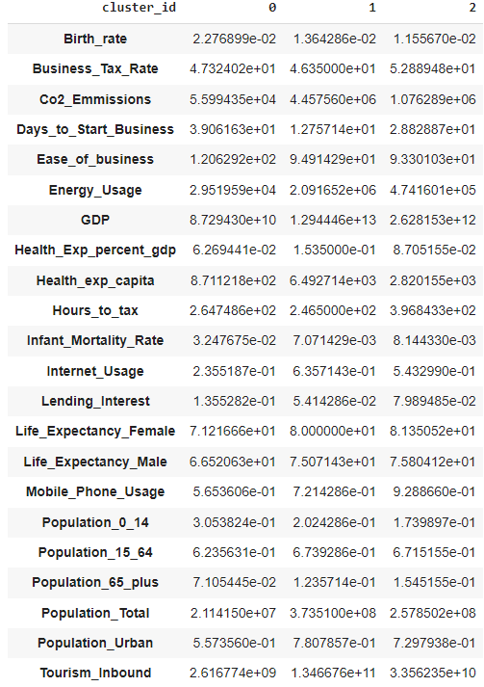
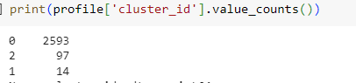
Model Building –Profiling (K-means)

Slide 18
Business Solution based on the feature relationships that can be utilized in different domains powered with the identified clusters.
Sustainable Energy Solutions: Given the positive correlation between energy usage and CO2 emissions, businesses can focus on developing and offering sustainable energy solutions. This can include renewable energy technologies, energy-efficient products, and services that help reduce carbon footprints. Companies can position themselves as environmentally conscious and cater to the growing demand for sustainable energy solutions.
Healthcare Technology and Services: With the positive correlation between health expenditure as a percentage of GDP and life expectancy, there is an opportunity for businesses in the healthcare sector. Companies can develop innovative healthcare technologies, telemedicine platforms, and digital health solutions to improve accessibility and quality of healthcare services. Collaborating with governments and insurance providers can further expand the reach of these solutions.
E-commerce and Mobile Technology: Given the strong positive correlation between internet usage and mobile phone usage, businesses can leverage the growing digital landscape. E-commerce companies can invest in user-friendly mobile applications, optimize their websites for mobile browsing, and enhance the overall customer experience. Additionally, businesses can explore mobile advertising and digital marketing strategies to target the increasing mobile user base.

Slide 19
Child and Family-oriented Businesses: With the strong positive correlation between birth rate and the population of individuals aged 0-14, businesses can target the child and family market. This can include products and services related to childcare, education, entertainment, and family-oriented experiences. Companies can develop innovative toys, educational tools, family-friendly resorts, or organize family events and activities.
Tourism and Hospitality: Considering the positive correlations between tourism inbound and various factors such as GDP, internet usage, and population urbanization, businesses can explore opportunities in the tourism and hospitality sector. This can involve setting up hotels, resorts, and restaurants in popular tourist destinations, offering unique travel experiences, or providing transportation and travel-related services.

Slide 21
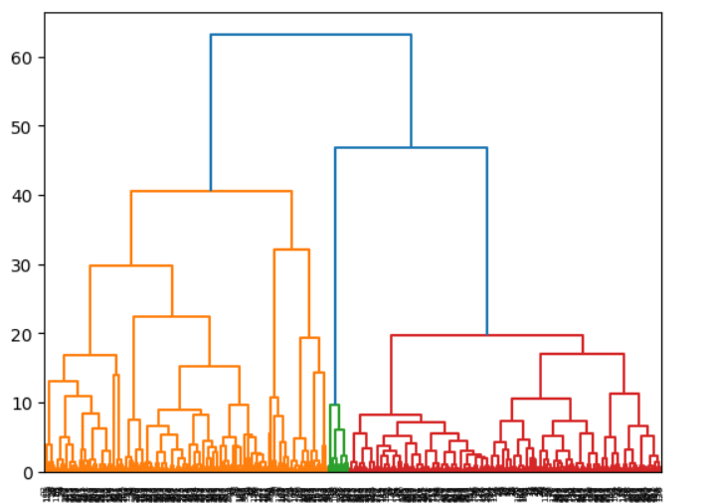
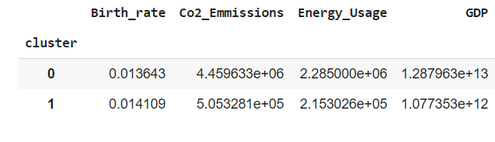
Agglomerative clustering:
We cluster whole country into two part (countries which are already developed and countries having higher GDP growth.)

Slide 22
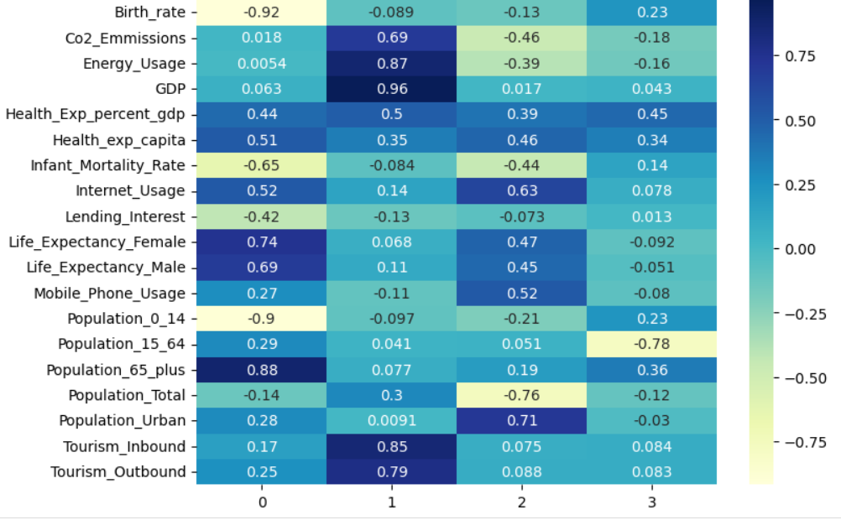
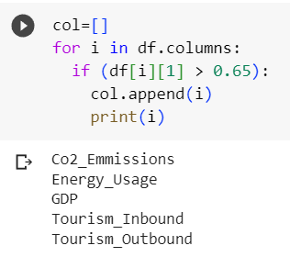
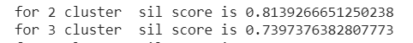
Factors taken into consideration with this data

Slide 23
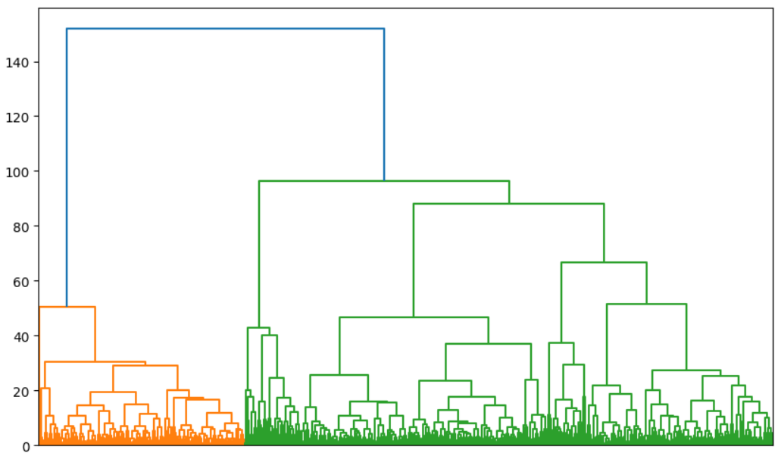
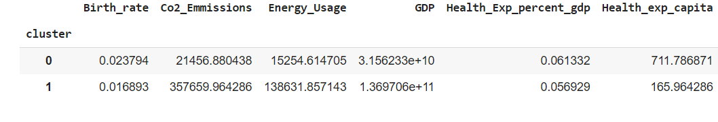
2)Developing Countries with lower GDP growth and under developed countries

Slide 24
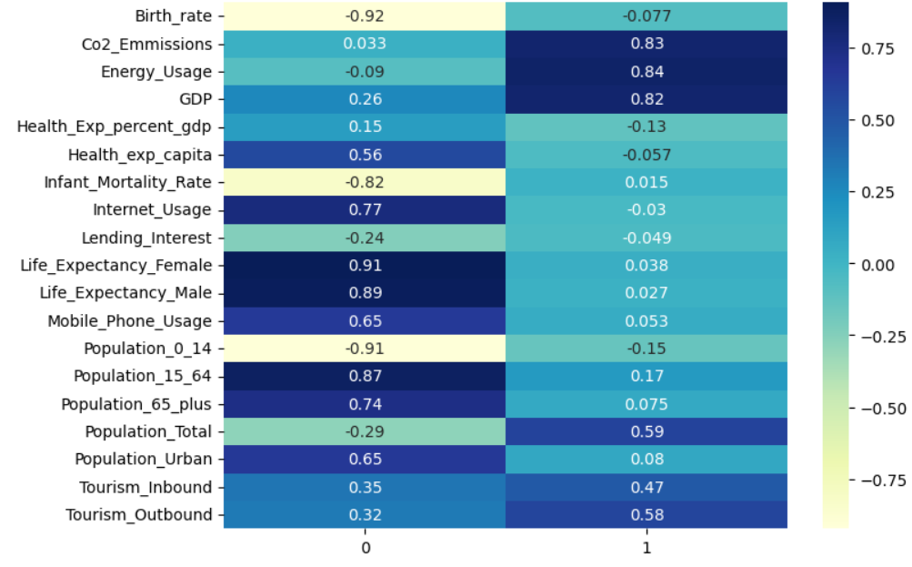
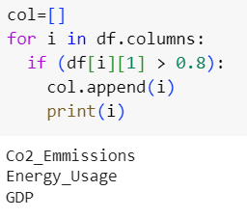
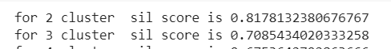
Factors taken into consideration for this data

Slide 25
DEPLOYMENT

Slide 26
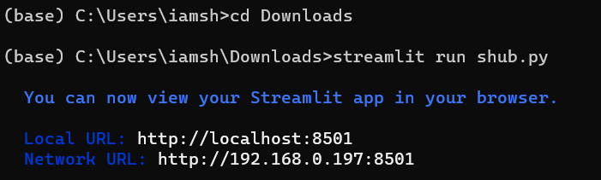
For deployment we have used streamlite and local host which will be predicting the country as developed ,developing with higher GDP,developing with lower GDP and under developed.

Slide 27
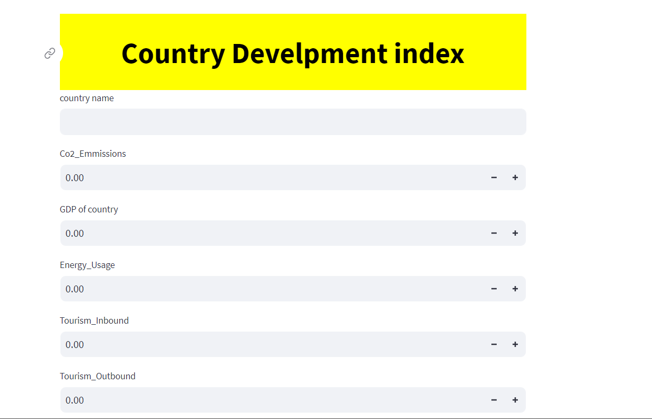
Deployment model

Slide 28
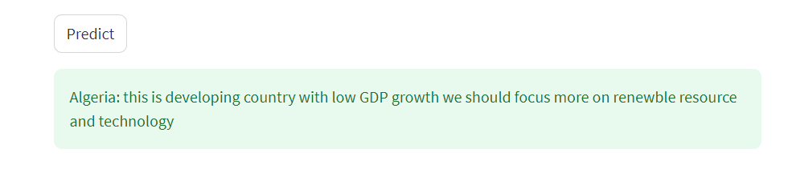
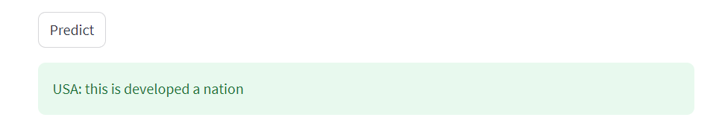

Slide 29
THANKYOU

